Slide 1

Welcome
to
Lecture
on
Basics of Fuzzy Logic and Fuzzy Systems
Dr Sushil Chauhan
Professor
Electrical Engineering Department
National Institute of Technology
Hamirpur - 177005

Slide 2
Contents
Topics
- Introduction
  Fuzzy Set Theory
    Fuzzy Sets
    Fuzzy Logic
  Fuzzy Knowledge-based Systems
  Applications

Slide 3
Bit of History
Fuzzy sets and basic ideas pertaining to their theory were first introduced by L A Zadeh in 1965 in his paper in the journal of ‘Information and Control’.

Slide 4
Development Phases
Academic Phase (1965-77)
-development of basic ideas of fuzzy set theory
-speculation about prospective applications
-small no of publications
Transformation Phase (1978-1988)
-significant advances in theory
-initial evidences of successful industrial applications
-increased no. of publications
Fuzzy Boom (since 1989)
-rapid increase in successful industrial applications
-major companies endorsed the theory and setup R&D centres
- computer software and hardware supporting applications of fuzzy logic became commercially available

Slide 5
Fuzzy Logic
This is the business of having “degrees” of membership rather than “in or out”
Truth values are between true and false
Introduced in 1965 to model uncertainty in natural language: tall, fair, nice, large, hot

Slide 6
Definition
Experts rely on common sense when they solve problems.
How can we model/represent expert knowledge that uses vague and ambiguous terms in a computer?
Fuzzy logic is not logic that is fuzzy, but logic that is used to describe fuzziness. Fuzzy logic is the theory of fuzzy sets, sets that calibrate vagueness.
Fuzzy logic is based on the idea that all things admit degrees. Temperature, height, speed, distance, beauty – all come on a sliding scale.
  The motor is running really hot.
  Tom is a very tall guy.

Slide 7
Definition
Since knowledge can be expressed in a more natural way by using fuzzy sets, many engineering and decision problems can be greatly simplified.
Boolean logic uses sharp distinctions. It forces us to draw lines between members of a class and non-members. For instance, we may say, Tom is tall because his height is 181 cm. If we drew a line at 180 cm, we would find that David, who is 179 cm, is small.
Is David really a small man or we have just drawn an arbitrary line in the sand?

Slide 8
When is to Use Fuzzy Logic ?
One or more of the control variables are continuous
Mathematical model of process does not exist
Difficult to encode even if exists
Model too complex to be evaluated fast enough for real time operation
Involves too much memory on designated chip arch.
While important to use inexpensive sensors and/or low precision micro-controller
High ambient noise level to deal with
Above all, an expert is available who can specify the rules underlying system behaviour

Slide 9
Fuzzy Logic
PROS:
Used to solve highly complex problems where mathematical modeling is too difficult/impossible
Tolerant of imprecise data
Universal approximation: can model arbitrary nonlinear functions
Intuitive
Based on linguistic terms
Convenient way to express expert and common sense knowledge

Slide 10
Fuzzy Logic
Cons:
Not a cure for all
Crisp/precise models can be more efficient and even convenient
Other approaches might be required to verify the work

Slide 11
Fuzzy Set Theory
The basic idea of the fuzzy set theory is that an element belongs to a fuzzy set with a certain degree of membership.
  A fuzzy set is a set with fuzzy boundaries
A proposition is neither true nor false (fuzzy logic), but may be partly true (or partly false) to any degree. This degree is usually taken as a real number in the interval [0,1]
  Fuzzy logic is an extension of classic two-valued logic – the truth value of a sentence is not restricted to true or false

Slide 12
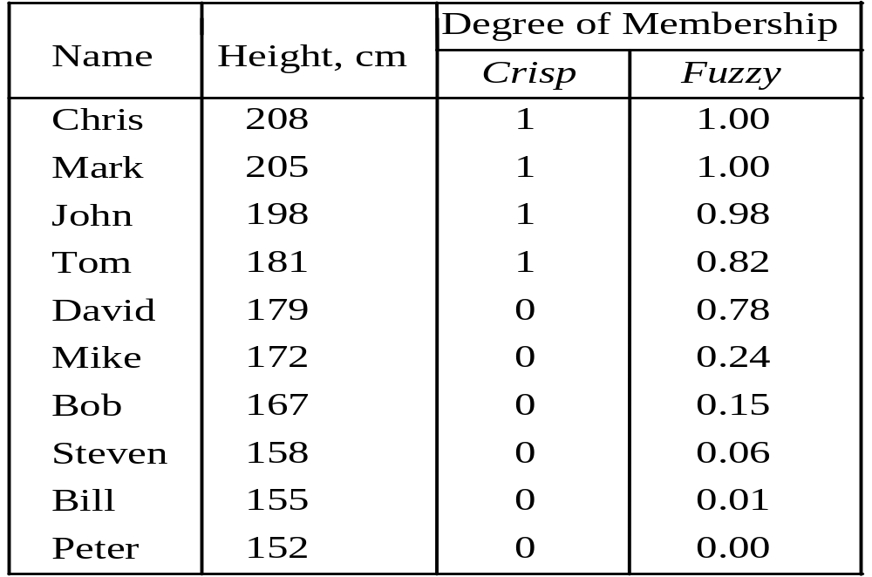
Fuzzy Sets
The classical example in fuzzy sets is tall men. The elements of the fuzzy set “tall men” are all men, but their degrees of membership depend on their height
tall men fuzzy Set

Slide 13
Fuzzy Sets
The x-axis represents the universe of discourse − the range of all possible values applicable to a chosen variable. In our case, the variable is the man height. According to this representation, the universe of men’s heights consists of all men.
The y-axis represents the membership value of the fuzzy set. In our case, the fuzzy set of tall men maps height values into corresponding membership values.

Slide 14
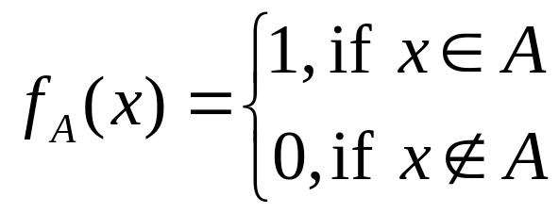
Fuzzy Sets
A fuzzy set is a set with fuzzy boundaries.
Let X be the universe of discourse and its elements be denoted as x. In the classical set theory, crisp set A of X is defined as function f_{A}(x) called the characteristic function of A
f_{A}(x) = {0, 1}, x →X where

Slide 15
Fuzzy Sets
In the fuzzy theory, fuzzy set A of universe X is defined by function μ_{A}(x) called the membership function of set A
μ_{A}(x): X → [0, 1],
where μ_{A}(x) = 1 if x is totally in A;
μ_{A}(x) = 0 if x is not in A;
0 < μ_{A}(x) < 1 if x is partly in A.
For any element x of universe X, membership function μ_{A}(x) equals the degree to which x is an element of set A. This degree, a value between 0 and 1, represents the degree of membership of element x in set A.

Slide 16
Fuzzy Sets
Sets with fuzzy boundaries
A = Set of tall people
Crisp set A
Fuzzy set A
1.0
1.0
.9
.5
Membership
function
180cm
Heights
170
178cm
Heights
Notes:
A fuzzy set is a set with fuzzy boundary. Suppose that A is the set of tall people. In a conventional set, or crisp set, an element is either belong to not belong to a set; there nothing in between. Therefore to define a crisp set A, we need to find a number, say, 5??, such that for a person taller than this number, he or she is in the set of tall people. For a fuzzy version of set A, we allow the degree of belonging to vary between 0 and 1. Therefore for a person with height 5??, we can say that he or she is tall to the degree of 0.5. And for a 6-foot-high person, he or she is tall to the degree of .9. So everything is a matter of degree in fuzzy sets. If we plot the degree of belonging w.r.t. heights, the curve is called a membership function. Because of its smooth transition, a fuzzy set is a better representation of our mental model of all? Moreover, if a fuzzy set has a step-function-like membership function, it reduces to the common crisp set.

Slide 17
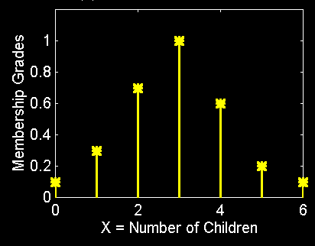
Fuzzy Sets with Discrete Universes
Fuzzy set C = “desirable city to live in”
  X = {Chd, Delhi, Mumbai} (discrete and non-ordered)
  C = {(Chd, 0.9), (Delhi, 0.8), (Mumbai, 0.6)}
Fuzzy set A = “sensible number of children”
  X = {0, 1, 2, 3, 4, 5, 6} (discrete universe)
  A = {(0, .1), (1, .3), (2, .7), (3, 1), (4, .6), (5, .2), (6, .1)}

Slide 18
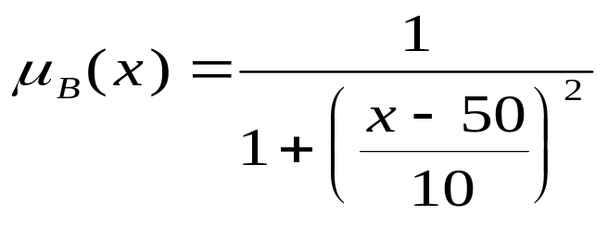
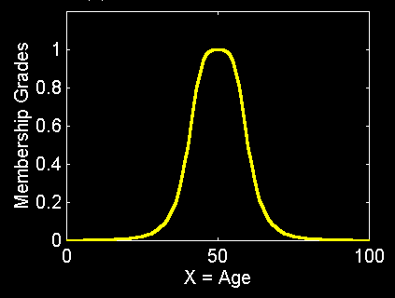
Fuzzy Sets with Cont. Universes
Fuzzy set B = “about 50 years old”
  X = Set of positive real numbers (continuous)
  B = {(x, μB(x)) | x in X}

Slide 19
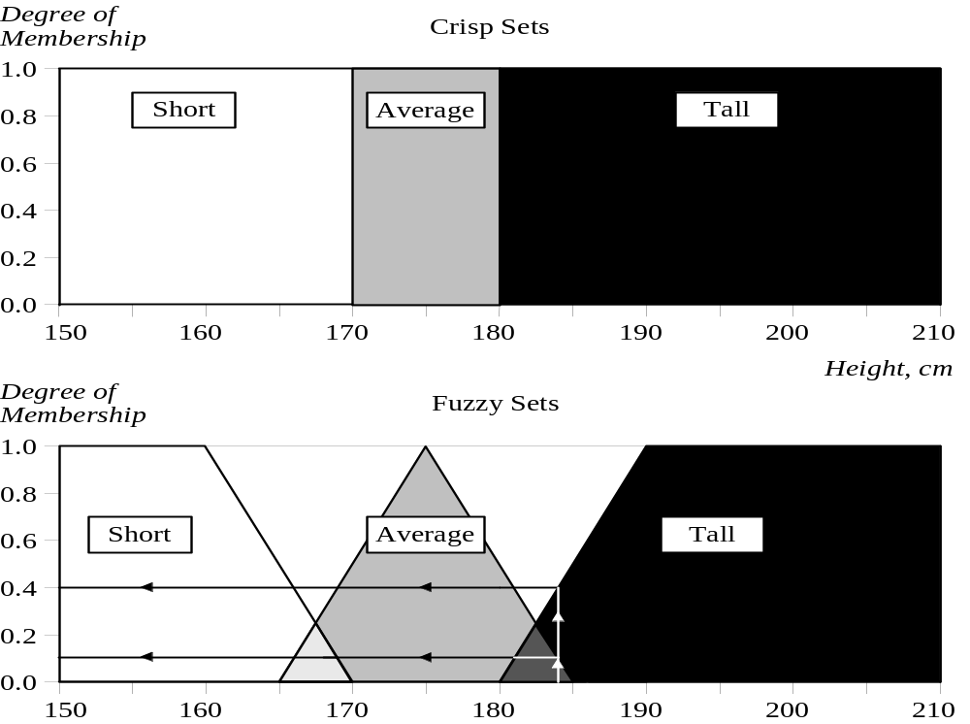
Fuzzy Sets
More crisp and fuzzy sets defined on the universe

Slide 20
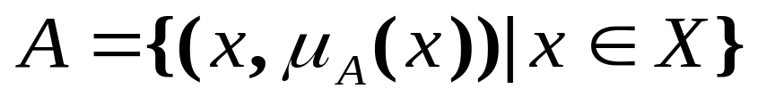
Fuzzy Sets
Formal definition:
  A fuzzy set A in X is expressed as a set of ordered pairs:
Membership
function
(MF)
Universe or
universe of discourse
Fuzzy set
A fuzzy set is totally characterized by a
membership function (MF).

Slide 21
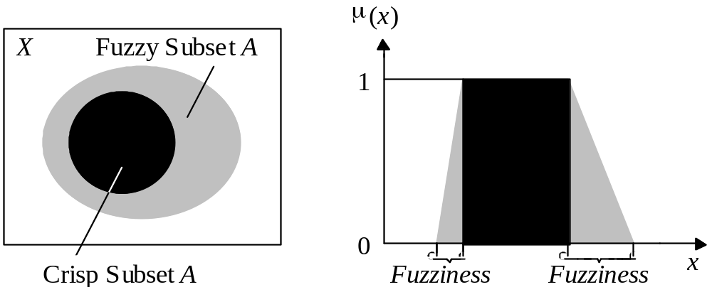
Fuzzy Sets
Typical functions that can be used to represent a fuzzy set are sigmoid, gaussian and pi. However, these functions increase the time of computation. Therefore, in practice, most applications Represent fuzzy subsets by linear fit functions.

Slide 22
Conceptualising in fuzzy terms
Standard membership functions:
  single-valued, or singleton
  triangular
  trapezoidal
  S-function (sigmoid function):
    S(u) = 0, u<=a
    S(u) = 2((u-a)/(c-a))2 , a <u <= b
    S(u) = 1 - 2((u-a)/(c -a))2 , b <u <= c
    S(u) = 1, u > c.

Slide 23
Conceptualizing in fuzzy terms...
More standard membership functions...
  Z function:
    Z(u)= 1 - S(u)
  Pi - function:
  P(u)=S(u), u<=b; P(u)=Z(u), u>b.
Two parameters must be defined for the quantization procedure:
  the number of the fuzzy labels;
  the form of the membership functions for each of the fuzzy labels.

Slide 24
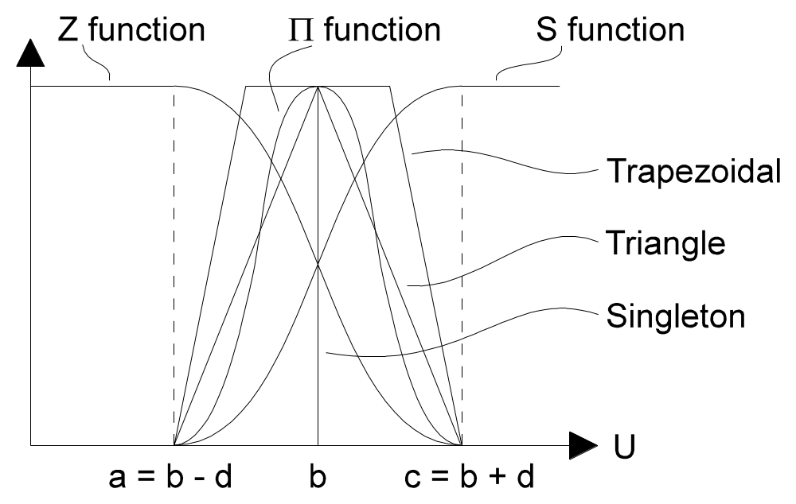
Conceptualizing in fuzzy terms...
Standard types of membership functions: Z function; S function; trapezoidal function; triangular function; singleton.

Slide 25
Fuzzy Sets
A linguistic variable is a fuzzy variable. For example, the statement “John is tall” implies that the linguistic variable John takes the linguistic value tall.
The range of possible values of a linguistic variable represents the universe of discourse of that variable.
For example, the universe of discourse of the linguistic variable speed might have the range between 0 and 220 km/h and may include such fuzzy subsets as very slow, slow, medium, fast, and very fast.

Slide 26
Fuzzy Sets
A linguistic variable carries with it the concept of fuzzy set qualifiers, called hedges.
Hedges are terms that modify the shape of fuzzy sets. They include adverbs such as very, somewhat, quite, more or less and slightly.

Slide 27
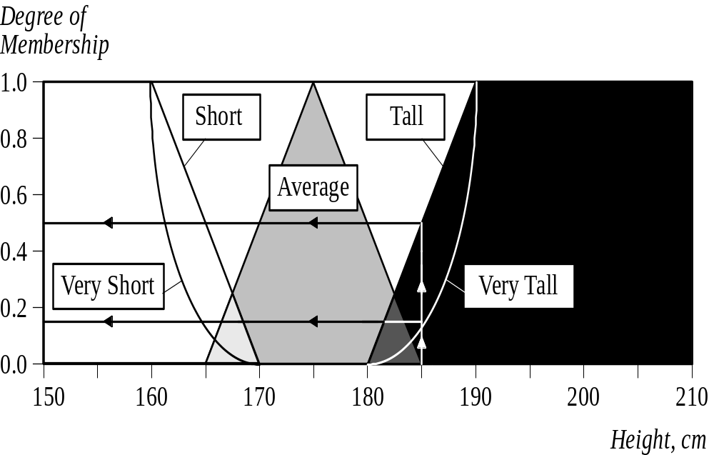
Fuzzy Sets
Fuzzy sets with the hedge very

Slide 28
Fuzzy Sets
Fuzzy set operation: Complement
Crisp Sets: Who does not belong to the set?
Fuzzy Sets: How much do elements not belong to the set?
The complement of a set is an opposite of this set. For example, if we have the set of tall men, its complement is the set of NOT tall men. When we remove the tall men set from the universe of discourse, we obtain the complement. If A is the fuzzy set, its complement ¬A can be found as follows:
μ¬_{A}(x) = 1 − μ_{A}(x)

Slide 29
Fuzzy Sets
Fuzzy set operation: Containment
Crisp Sets: Which sets belong to which other sets?
Fuzzy Sets: Which sets belong to other sets?
The set of tall men contains all tall men; very tall men is a subset of tall men. However, the tall men set is just a subset of the set of men. In crisp sets, all elements of a subset entirely belong to a larger set. In fuzzy sets, however, each element can belong less to the subset than to the larger set. Elements of the fuzzy subset have smaller memberships in it than in the larger set.

Slide 30
Fuzzy Sets
Fuzzy set operation: Intersection
Crisp Sets: Which element belongs to both sets?
Fuzzy Sets: How much of the element is in both sets?
In classical set theory, an intersection between two sets contains the elements shared by these sets. For example, the intersection of the set of tall men and the set of fat men is the area where these sets overlap. In fuzzy sets, an element may partly belong to both sets with different memberships. A fuzzy intersection is the lower membership in both sets of each element. The fuzzy intersection of two fuzzy sets A and B on universe of discourse X:
μ_{A}∩_{B}(x) = min [μ_{A}(x), μ_{B}(x)] = μ_{A}(x) ∩ μ_{B}(x),
where x∈X

Slide 31
Fuzzy Sets
Fuzzy set operation: Union
Crisp Sets: Which element belongs to either set?
Fuzzy Sets: How much of the element is in either set?
The union of two crisp sets consists of every element that falls into either set. For example, the union of tall men and fat men contains all men who are tall OR fat. In fuzzy sets, the union is the reverse of the intersection. That is, the union is the largest membership value of the element in either set. The fuzzy operation for forming the union of two fuzzy sets A and B on universe X can be given as:
μ_{A}∪_{B}(x) = max [μ_{A}(x), μ_{B}(x)] = μ_{A}(x) ∪ μ_{B}(x),
where x∈X

Slide 32
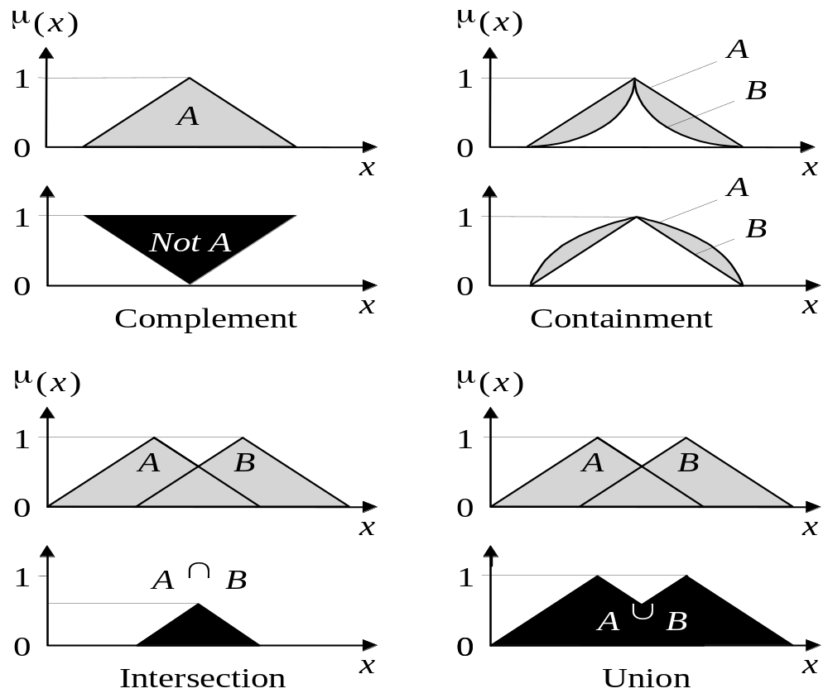
Fuzzy Sets
Operations of fuzzy sets

Slide 33
More Definitions
Support
Core
Normality
Crossover points
Fuzzy singleton
α-cut, strong α-cut
Convexity
Fuzzy numbers
Bandwidth
Symmetricity
Open left or right, closed

Slide 34
MF Terminology
MF
1
.5
α
0
Core
X
Crossover points
α - cut
Support

Slide 35
Band width is |x2-x1| where x2 and x1 are crossover points.
Symmetry µ_{A}( c+x) = µ_{A}( c-x) for all x Є X. Then A is symmetric.

Slide 36
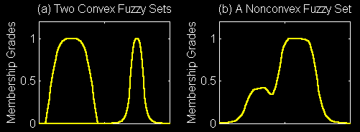
Convexity of Fuzzy Sets
A fuzzy set A is convex if for any λ in [0, 1],
Alternatively, A is convex if all its α-cuts are convex.

Slide 37
Alpha Cuts
A is a fuzzy set in X
A_{α} = {x | μ_{A}(x)≥α } is the a-cut of A in X
Strong a-cut is A_{a} = {x | μ_{A} (x)> α }
Alpha cuts are crisp sets

Slide 38
Fuzzy Relations
The fuzzy relation R between Sets X and Y is a fuzzy set in the Cartesian product X×Y
μ_{R}: X × Y → [0,1] gives the degree to which x and y are related to each other in R.

Slide 39
Composition of Relations
Two fuzzy relations R in X × Y and S in Y × Z can be composed into R°S in X × Z as
μ_{R°S}(x,z) = max_{y∈Y}[min[μ_{R}(x,y), μ_{S}(y,z)]]

Slide 40
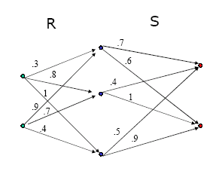
Composition Example
X
Z
Y

Slide 41
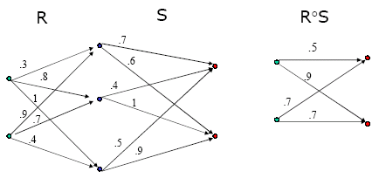

Slide 42
Fuzzy Knowledge-based Systems
Fuzzy Knowledge-based Systems or Fuzzy Control Systems are a special type of truth-functional multi-valued logic
Fuzzy rules are used to relate fuzzy sets
The truth value of each fuzzy rule is 1
Fuzzy rule representation
  IF x is A
  THEN y is B
where x and y are linguistic variables; and A and B are linguistic values determined by fuzzy sets on the universe of discourses X and Y, respectively.

Slide 43
Fuzzy Knowledge-based Systems
A fuzzy rule can have multiple antecedents
IF project_duration is long
AND project_staffing is large
AND project_funding is inadequate
THEN risk is high
The consequent of a fuzzy rule can also include multiple parts
IF temperature is hot
THEN hot_water is reduced;
cold_water is increased

Slide 44
Fuzzy Knowledge-based Systems
Difference between crisp and fuzzy rules
Crisp rule:
  IF speed is >100
  THEN stopping_distance is long
Fuzzy rule:
  IF speed is fast
  THEN stopping_distance is long
In a fuzzy system, all rules fire to some extent, or in other words they fire partially. If the antecedent is true to some degree of membership, then the consequent is also true to that same degree.

Slide 45
Fuzzy Knowledge-based Systems
Mamdani fuzzy inference model
in four steps
fuzzification of the input variables
rule evaluation
aggregation of the rule outputs
defuzzification

Slide 46
Fuzzy Knowledge-based Systems
We examine a simple two-input one-output problem that includes three rules:
Rule: 1 Rule: 1
IF x is A3 IF project_funding is adequate
OR y is B1 OR project_staffing is small
THEN z is C1 THEN risk is low
Rule: 2 Rule: 2
IF x is A2 IF project_funding is marginal
AND y is B2 AND project_staffing is large
THEN z is C2 THEN risk is normal
Rule: 3 Rule: 3
IF x is A1 IF project_funding is inadequate
THEN z is C3 THEN risk is high

Slide 47
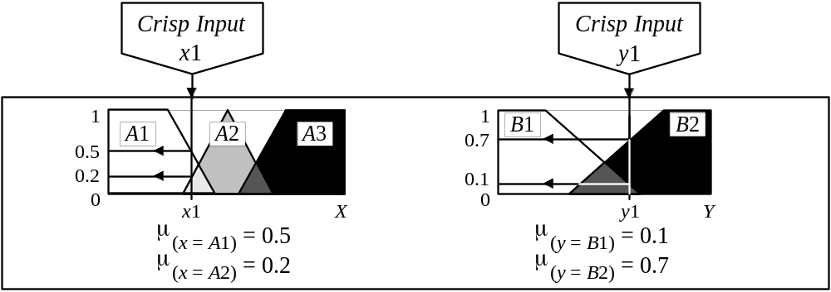
Fuzzy Knowledge-based Systems
Step 1: Fuzzification
Take the crisp inputs, x1 and y1 (project funding and project staffing), and determine the degree to which these inputs belong to each of the appropriate fuzzy sets.

Slide 48
Fuzzy Knowledge-based Systems
Step 2: Rule Evaluation
Take the fuzzified inputs, μ_{(x=A1)} = 0.5, μ_{(x=A2)} = 0.2, μ_{(y=B1)} = 0.1 and μ_{(y=B2)} = 0.7, and apply them to the antecedents of the fuzzy rules.
If a given fuzzy rule has multiple antecedents, the fuzzy operator (AND or OR) is used to obtain a single number that represents the result of the antecedent evaluation.
This number (the truth value) is then applied to the consequent membership function.

Slide 49
Fuzzy Knowledge-based Systems
Step 2: Rule Evaluation (Cont.)
To evaluate the disjunction of the rule antecedents, we use the OR fuzzy operation. Typically, fuzzy expert systems make use of the classical fuzzy operation union:
    μ_{A}∪_{B}(x) = max [μ_{A}(x), μ_{B}(x)]
Similarly, in order to evaluate the conjunction of the rule antecedents, we apply the AND fuzzy operation intersection:
    μ_{A}∩_{B}(x) = min [μ_{A}(x), μ_{B}(x)]

Slide 50
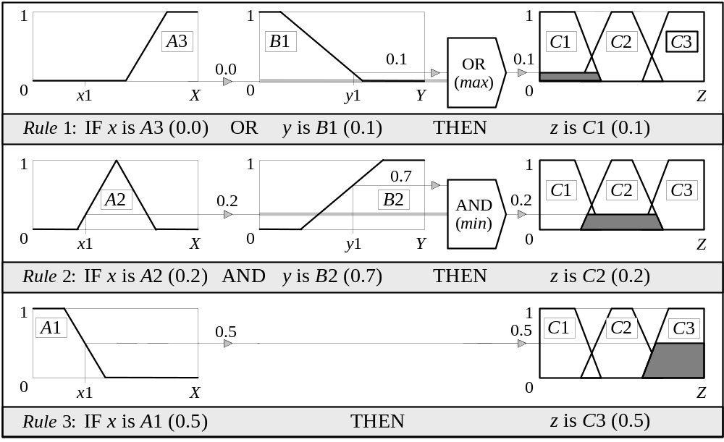
Fuzzy Knowledge-based Systems
Step 2: Rule Evaluation (Cont.)
Mamdani-style rule evaluation

Slide 51
Fuzzy Knowledge-based Systems
Step 2: Rule Evaluation (Cont.)
Clipping : The most common method of correlating the rule consequent with the truth value of the rule antecedent is to cut the consequent membership function at the level of the antecedent truth.
Since the top of the membership function is sliced, the clipped fuzzy set loses some information.
Clipping is still often preferred because it involves less complex and faster mathematics, and generates an aggregated output surface that is easier to defuzzify.

Slide 52
Fuzzy Knowledge-based Systems
Step 2: Rule Evaluation (Cont.)
Scaling: The original membership function of the rule consequent is adjusted by multiplying all its membership degrees by the truth value of the rule antecedent.
Scaling offers a better approach for preserving the original shape of the fuzzy set; it generally loses less information and can be very useful in fuzzy expert systems.

Slide 53
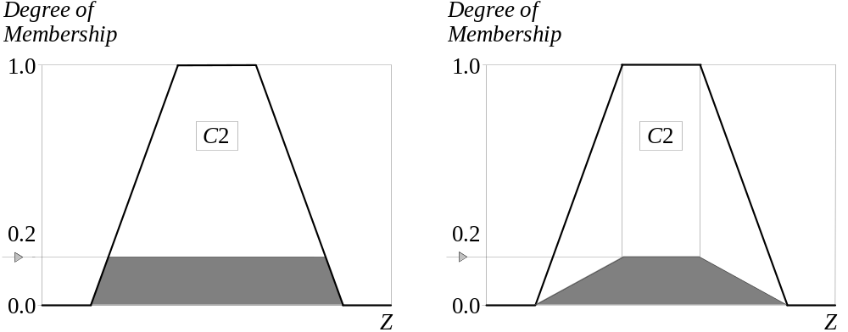
Fuzzy Knowledge-based Systems
Step 2: Rule Evaluation (Cont.)
Clipped and scaled membership functions

Slide 54
Fuzzy Knowledge-based Systems
Step 3: Aggregation of the rule outputs
Aggregation is the process of unification of the outputs of all rules. We take the membership functions of all rule consequents previously clipped or scaled and combine them into a single fuzzy set.
The input of the aggregation process is the list of clipped or scaled consequent membership functions, and the output is one fuzzy set for each output variable.

Slide 55
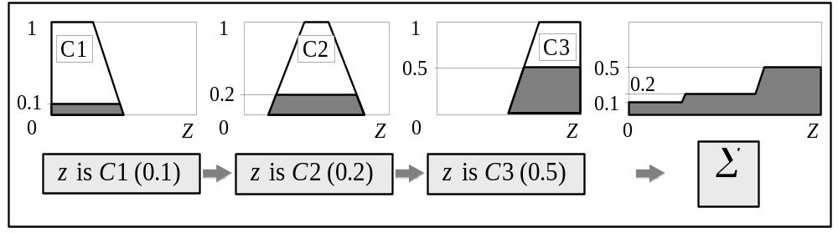
Fuzzy Knowledge-based Systems
Step 3: Aggregation of the rule outputs (Cont.)
Aggregation of the rule outputs

Slide 56
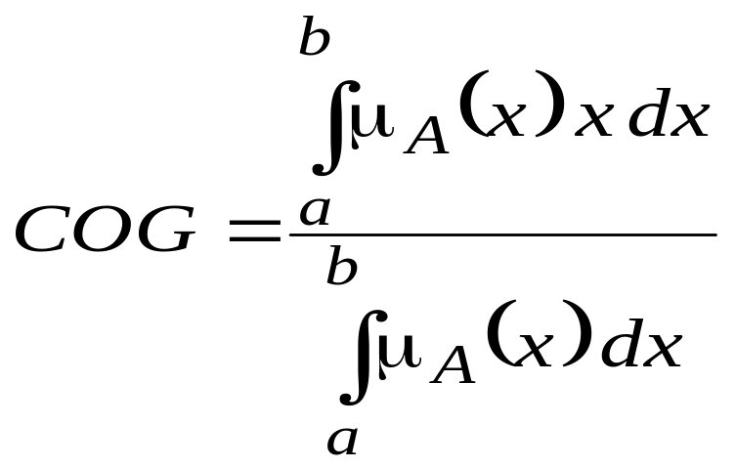
Fuzzy Knowledge-based Systems
Step 4: Defuzzification
The input for the defuzzification process is the aggregate output fuzzy set and the output is a single number.
Centroid technique based defuzzification methods. It finds the point where a vertical line would slice the aggregate set into two equal masses. Mathematically this centre of gravity (COG) can be expressed as:

Slide 57
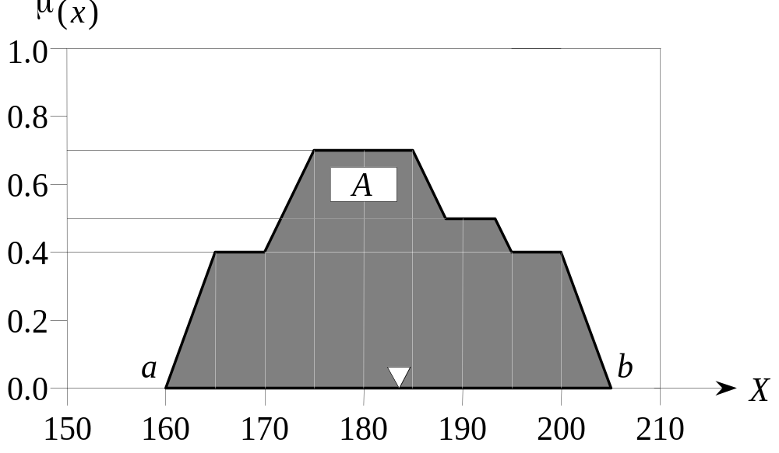
Fuzzy Knowledge-based Systems
Step 4: Defuzzification (Cont.)
COG can be obtained by calculating it over a sample of points.

Slide 58
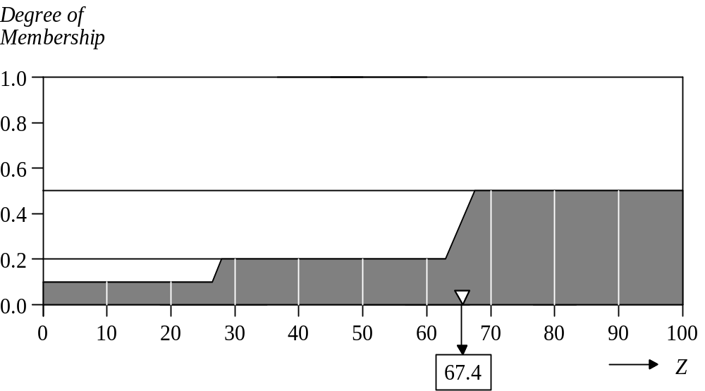
Fuzzy Knowledge-based Systems
Example COG calculation:

Slide 59
Fuzzy Knowledge-based Systems
Finding the centroid of a two-dimensional shape by integrating across a continuously varying function is not computationally efficient.
Sugeno fuzzy inference model: Michio Sugeno suggested to use a single spike, a singleton, as the membership function of the rule consequent. A singleton, or more precisely a fuzzy singleton, is a fuzzy set with a membership function that is unity at a single particular point on the universe of discourse and zero everywhere else.

Slide 60
Fuzzy Knowledge-based Systems
Rule representation of Sugeno fuzzy inference model is very similar to the Mamdani method. Sugeno changed only a rule consequent. Instead of a fuzzy set, he used a mathematical function of the input variable.
IF x is A
AND y is B
THEN z is f(x, y)
where x, y and z are linguistic variables; A and B are fuzzy sets on universe of discourses X and Y, respectively; and f (x, y) is a mathematical function.

Slide 61
Fuzzy Knowledge-based Systems
The most commonly used zero-order Sugeno fuzzy model applies fuzzy rules in the following form:
IF x is A
AND y is B
THEN z is k
where k is a constant.
In this case, the output of each fuzzy rule is constant. All consequent membership functions are represented by singleton spikes.

Slide 62
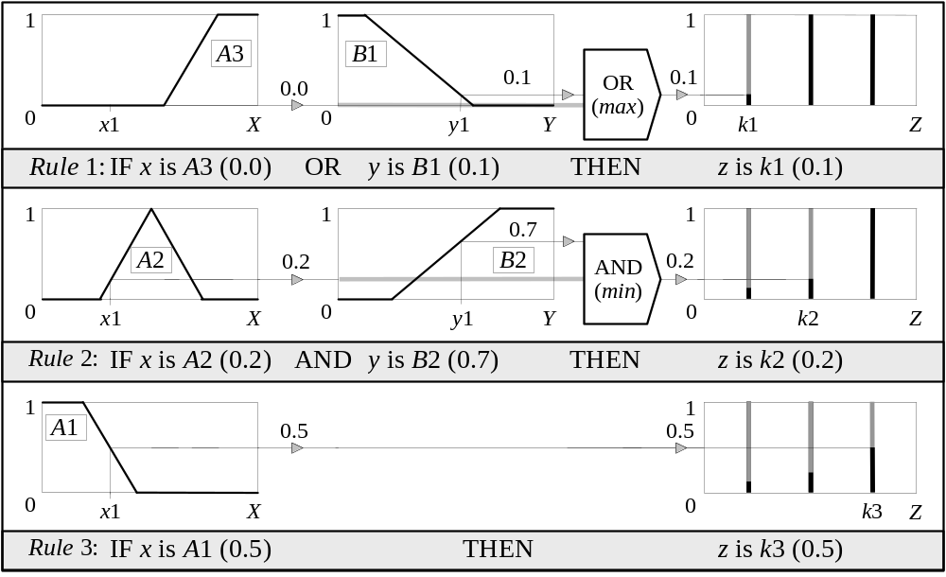
Fuzzy Knowledge-based Systems
Sugeno-style rule evaluation

Slide 63
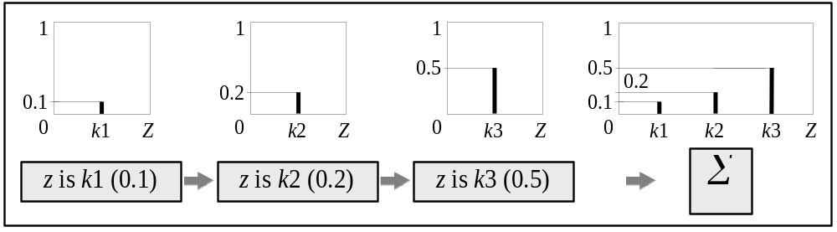
Fuzzy Knowledge-based Systems
Sugeno-style aggregation of the rule outputs

Slide 64
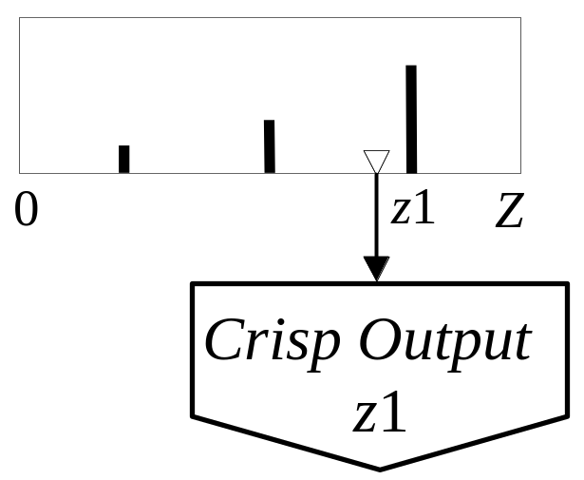
Fuzzy Knowledge-based Systems
Sugeno-style defuzzification: Weighted average (WA)

Slide 65
Fuzzy Knowledge-based Systems
Mamdani method is widely accepted for capturing expert knowledge. It allows us to describe the expertise in more intuitive, more human-like manner. However, Mamdani-type fuzzy inference entails a substantial computational burden.
On the other hand, Sugeno method is computationally effective and works well with optimization and adaptive techniques, which makes it very attractive in control problems, particularly for dynamic nonlinear systems.

Slide 66
Fuzzy Knowledge-based Systems
Development of fuzzy expert systems
1. Specify the problem and define linguistic variables.
2. Determine fuzzy sets.
3. Elicit and construct fuzzy rules.
4. Encode the fuzzy sets, fuzzy rules and procedures to perform fuzzy inference into the expert system.
5. Evaluate and tune the system.

Slide 67
Fuzzy Knowledge-based Systems
Tuning fuzzy systems
1. Review modelled input & output variables, and if required redefine their ranges.
2. Review the fuzzy sets, and if required define
additional sets on the universe of discourse.
The use of wide fuzzy sets may cause the fuzzy system to perform roughly.
3. Provide sufficient overlap between neighbouring sets. It is suggested that triangle-to-triangle and trapezoid-to-triangle fuzzy sets should overlap between 25% to 50% of their bases.

Slide 68
Fuzzy Knowledge-based Systems
Tuning fuzzy systems (Cont.)
4. Review the existing rules, and if required add new rules to the rule base.
5. Examine the rule base for opportunities to write hedge rules to capture the pathological behaviour of the system.
6. Adjust the rule execution weights. Most fuzzy
logic tools allow control of the importance of rules by changing a weight multiplier.
7. Revise shapes of the fuzzy sets. In most cases, fuzzy systems are highly tolerant of a shape approximation.

Slide 69
Other Applications
compensation against vibrations in camcorders
home appliances (washing machines, dish washers, rice cookers, etc.)
recognition of handwriting, objects, voice
image processing
flight aid for helicopters
simulation for legal proceedings
improvement of fuel-consumption for automobiles
early recognition of earthquakes
“and in almost any other field you can think of”

Slide 70
Limitations of Fuzzy Logic
Stability: since fuzzy logic is not formal, there is no guarantee that a fuzzy system will function correctly
Learning: no ability to learn membership functions and no memory to learn during problem solving
Determining good membership functions and fuzzy rules is not always easy or straightforward
Verification and Validation requires extensive testing (as in any expert system). This is especially important of controllers where safety becomes a key factor (e.g. subway system, space shuttle)

Slide 71
Future Development - Hybrids
Fuzzy neural net: the two areas can complement each other weakness (fuzzy logic - does not learn, neural networks - little control)
Fuzzy genetic algorithms: GAs can be used to tune membership functions

Slide 72
References
Timothy Ross,”Fuzzy Logic with Engineering Applications” Published by Mc Graw Hill
H. A Toliyat, M.S. Arefeen,”Introduction to Fuzzy Logic”
B K Bose,”Fuzzy Logic and Neural Network Applications”
Ahmad M Ibrahim, “Applied Fuzzy Logic Controllers” Published by PHI
Johon Yeri, Raza Langari, “ Fuzzy Logic Intelligence Control and Information” Published by Pearson Education Pvt. Limited
George J. Klir and Bo Yuan, “Fuzzy Sets and Fuzzy Logic Theory and Applications”, Published by PHI

Slide 73


Slide 74
Example of a Fuzzy Controller
A cart on a 4-meter long track. The goal is to return
the cart to the center of the track with 0 velocity. The
available control is to push or pull on the cart.
-2m
0m
2m

Slide 75
Cart Position
m(x)
left
middle
right
1.0
notice that sets overlap
0.0
x
-2m
-1m
0m
1m
2m

Slide 76
Cart Velocity
m(x)
moving
left
standing
still
moving
right
1.0
0.0
x
-1m/s
-0.5m/s
0m/s
1m/s
2m/s

Slide 77
Cart Force
m(F)
pull
push
1.0
none
0.0
F
-1N
-0.5N
0N
0.5N
1N

Slide 78
Simple Control Rules
If left then push
If right then pull
If middle then none
If moving left then push
If standing still then none
If moving right then pull
If left and moving left then push
If right and moving right then pull

Slide 79
Fuzzy control algorithms
Find the sensor values
  For example, the position might be x = -0.5 meters and v = 0.
Calculate the fuzzy membership
  For example, m_{middle}(x = -0.5) = 0.5 and m_{left}(x = -0.5) = 0.5. Note the overlap between multiple categories!
Calculate the membership of the rule antecedents for all control rules. This may involve calculating intersections as described on the previous slide.
  For example if the antecedent is “If left and moving left” then we take the minimum of m_{left}(x) and m_{moving-left}(x).
Apply the rules (how to do this is not specified here). The result is a collection of fuzzy sets that describe the recommended action (i.e., the control rule consequent) based on each control rule.
Aggregate the results from all control rules (“how to” is not specified here).
“De-fuzzify” this recommendation to arrive at a single-valued action recommendation.

Slide 80
Applications
Soft computing
Fuzzy expert systems
Fuzzy Control

Slide 81
Steps needed for building a Fuzzy Logic Controller or Fuzzy Expert System
Step 1.- Determine the values of the input and output variables.
Step 2.- Fuzzify the variables: create fuzzy sets to represent the
different values of the input variables.
Step 3.- Create fuzzy sets for the output variables of the system.
Step 4.- Generate a set of fuzzy rules based on the input and
output fuzzy sets.
Step 5.- Choose a deffuzification method and apply it to the
results obtained from the rules that are satisfied.
Step 6.- The crisp value obtained from Step 5 is the answer to
your problem.

Slide 82
Fuzzy Logic (Introduction)
What is Fuzziness?
Fuzziness is deterministic uncertainty. It is concerned with the degree to which events occur rather than the likelihood of their occurrence. For example, the degree to which a person is tall is a fuzzy event rather than a random event.
Fuzziness vs. Probability
  Fuzziness is deterministic uncertainty – probability is nondeterministic.
  Probabilistic uncertainty dissipates with increasing number of occurrences fuzziness does not.
  Fuzziness describes event ambiguity – probability describes event occurrence. Whether an event occurs is random. The degree to which it occurs is fuzzy.

Slide 83
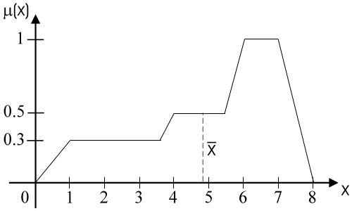
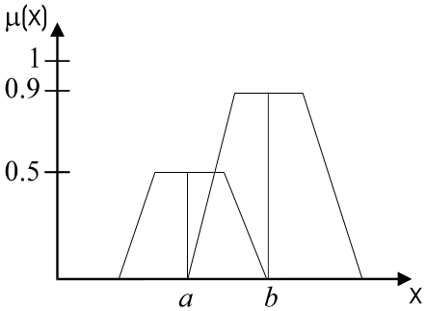
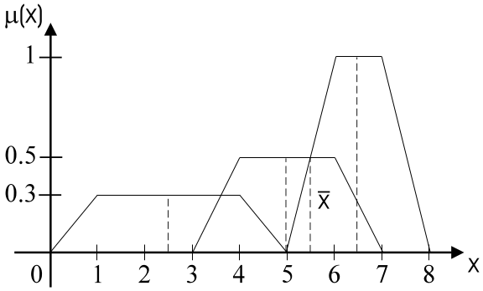
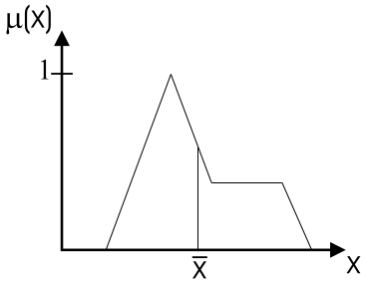
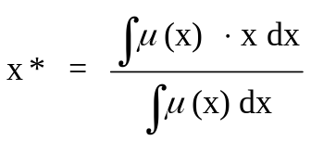
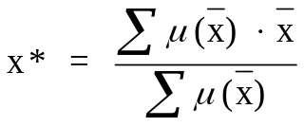
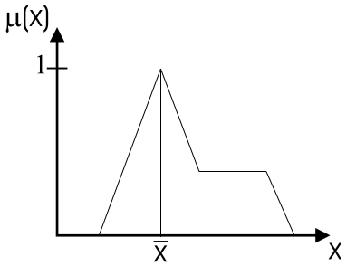
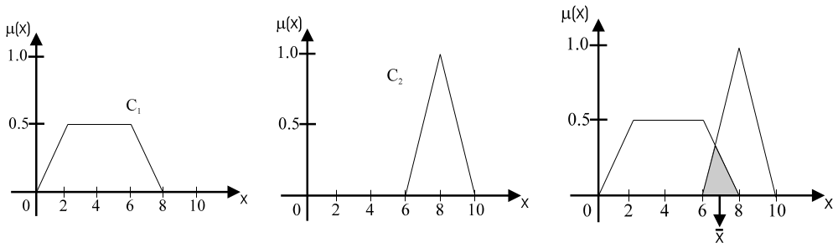
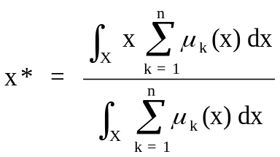
Defuzzification methods
Weighted average
Centroid
Max-membership
or Height method
μ ( x* ) >= (μ ( x ))
Center of sums
Mean-max membership
x * = (a + b) / 2

Slide 84
Fuzzy Rules
Fuzzy rules are useful for modeling human thinking, perception and judgment.
A fuzzy if-then rule is of the form “If x is A then y is B” where A and B are linguistic values defined by fuzzy sets on universes of discourse X and Y, respectively.
“x is A” is called antecedent and “y is B” is called consequent.

Slide 85
Examples, for such a rule are
● If pressure is high, then volume is small.
● If the road is slippery, then driving is dangerous.
● If the fruit is ripe, then it is soft.

Slide 86
Example: Fuzzy rules
A fuzzy rule is a linguistic expression of causal dependencies between linguistic variables in form of if-then statements.
General form: IF <antecedent> then <consequence>
Example:
  If temperature is cold and oil price is cheap
    Then heating is high
Linguistic variables
Linguistic values

Slide 87
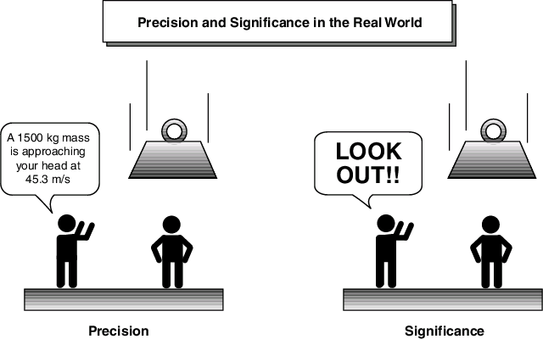
Fuzzy Logic : An Idea

Slide 88
Why?
Why fuzzy?
As Zadeh said, the term is concrete, immediate and descriptive; we all know what it means. However, many people in the West were repelled by the word fuzzy, because it is usually used in a negative sense.
Why logic?
Fuzziness rests on fuzzy set theory, and fuzzy logic is just a small part of that theory.

Slide 89
The Term “Fuzzy Logic”
The term fuzzy logic is used in two senses:
  Narrow sense: Fuzzy logic is a branch of fuzzy set theory, which deals (as logical systems do) with the representation and inference from knowledge. Fuzzy logic, unlike other logical systems, deals with imprecise or uncertain knowledge. In this narrow, and perhaps correct sense, fuzzy logic is just one of the branches of fuzzy set theory.
  Broad Sense: fuzzy logic synonymously with fuzzy set theory

Slide 90
Fuzzy Logic
Fuzzy logic is an extension of classic two-valued logic – the truth value of a sentence is not restricted to true or false
Example fuzzy sentences:
  Φ = Height(John, tall) |Φ| = 0.9
  Ψ = Speed(Mazda, fast) |Ψ| = 0.3
The truth value of each logic connective can be defined:
  |¬Φ| = 1 – |Φ|
  |Φ ∧ Ψ| = min {|Φ|, |Ψ|} /* t-norm */
  |Φ ∨ Ψ| = max {|Φ|, |Ψ|} /* t-conorm */
  |Φ →Ψ| = min {1 - |Φ| + |Ψ|, 1} /* Lukasiewicz */

Slide 91
Fuzzy Logic
Four types of fuzzy logics
  Classic logic
    Crisp setence: Height(John, 180) → Weight(John, 60)
    Crisp data: Height(John, 180)
  Truth-functional multi-valued logic (Fuzzy knowledge base)
    Fuzzy sentence: Height(John, tall) → Weight(John, heavy)
    Crisp data: Height(John, 180)
  Possibilistic logic (Uncertain knowledge base)
    Crisp sentence: Height(John, 180) → Weight(John, 60)
    Fuzzy data: Height(John, tall)
  Uncertain fuzzy knowledge base
    Fuzzy sentence: Height(John, tall) → Weight(John, heavy)
    Fuzzy data: Height(John, tall)

Slide 92
Fuzzy Logic
Fuzzy Inference
  Classic logic
    Resolution – sound and complete
    {l₁∨l₂, L₁∨¬l₂}├_{res} {l₁∨L₁}
  Possibilistic logic
    Possibilistic resolution principle – sound and complete
    {(l₁∨l₂,α₁), (L₁∨¬l₂, α₂)}├_{pres}
    {l₁∨L₁,min{α₁, α₂}}

Slide 93
Fuzzy Logic
  Truth-functional multi-valued logic (Fuzzy knowledge base)
    Generalized Modus Ponens – sound and complete
    According to Lukasiewicz:
    |Φ →Ψ| = min {1 - |Φ| + |Ψ|, 1}
    => |Φ →Ψ| ≤ 1 - |Φ| + |Ψ|
    => if set | Φ →Ψ | = 1 - |Φ| + |Ψ| => then |Ψ| = |Φ| + (|Φ →Ψ| – 1)
    |Ψ| = |Φ| if |Φ →Ψ| = 1, i.e., the truth value of Φ →Ψ is always true, which serves as the basis for using “clipping” to get output in Fuzzy Control or Knowledge-based Systems

